Slide 1
CodePath
Week 9 (Cont’d)
CS 4760 F18
Christopher Raley

Slide 2
Homework
Week 9 Homework Report 11/11 @ 11:59 PM
Still CodePath Week 9
Milestones 1 - 5 for CodePath Assignment
Submit on Collab

Slide 3
Homework
Week 9 CodePath Assignment 11/11 @ 11:59 PM
Submit according to CodePath guidelines

Slide 4
NetSec Crash Course
Firewalls
Intrusion Detection System
Risk Assessment
Penetration Testing
Threat Monitoring
Incident Response
Topics
Week 9 (Cont’d)
Readings on course website

Slide 5
Honeypots
A honeypot is a decoy application, server, or other networked resource
Purpose
Attract and trap hackers
Learn technique the hacker uses to enter network
Allows for a profile to be built
Learn new or unconventional hacking methods

Slide 6
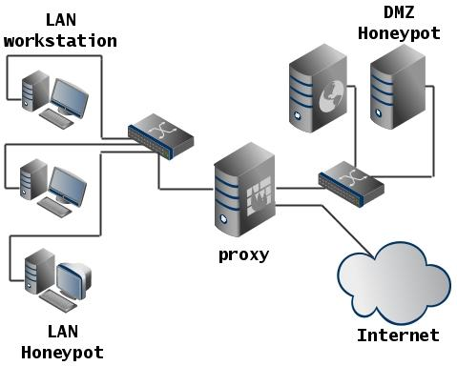

Slide 7
Honeypots
Low-interaction honeypots: Simulation of target resources
Usually virtualization
Example: Emulated SSH server
High-interaction honeypots: Expose a real target’s resources to attract sophisticated attackers
Example: Real SSH server with misconfigured settings to be vulnerable on purpose

Slide 8
Goals
Configure and deploy your own honeypot server
Has an attack surface that is vulnerable to a network-based attack
Network security feature such as an IDS configured to detect and log such attacks

Slide 9
Modern Honey Network (MHN)
Open source honeypot you will be using for the assignment
Need 2 VM’s
Admin VM
Used to deploy honeypots
Honeypot VM

Slide 10
Google Cloud
Will need a cloud service provider in order to host the honeypots
Use Google Cloud platform
It is free, but you will need to delete and shut down your service by the time you are done with it

Slide 11
Notes
Read all instruction carefully
Install all required software/utilities as stated in the directions
Will be accessing honeypots mainly through a terminal
Should work on host machine, but if not try a VM
Can take at least 30-40 minutes so don’t procrastinate

Slide 12
Office Hours
Monday / Thursday / Sunday : 5 - 7 PM @ Rice 226

